Slide 1
Create a musical instrument with Arduino
Some sensors and a little imagination !
Jérôme Baton, wadael@gmail.com

Slide 2
Arduino ??
What is it ?
It's a lille blue card with a chip into you can put YOUR program
It has PINS for connecting electronic parts
There is two categories of parts
Sensors (temperature, luminosity, …)
Actuators, like LEDs, motors, etc ...

Slide 3
Arduino ??
What is it ?
Why two categories of parts :
Sensors convert 'something' to electrical power
Actuators convert electrical power to 'something'
Its the program that controls the parts
Notes:
Expliquer aux enfants que le qqchose, c'est de l'énergie.
Lumineuse, cinétique (mouvement)
Explain the kids that 'something' is energy
Light energy
Cinematic energy

Slide 4
The project
Creation of a musical instrument
No need to blow air into it
Less lung-tiring and skill demanding than a trumpet
No chords either
Thus doesn't hurt the fingers
Clearly two major advantages
Have you heard (about) Jean-Michel Jarre ? (contemporary French musician)

Slide 5
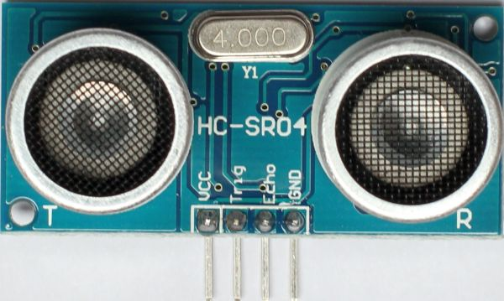
The project's principles
Not numerous and simples :
Distance sensors mesure distances.
Its that thing
with two eyes →
(looking at you)
Cheap, around 2€
Per unit

Slide 6
The project's principles
Not numerous and simples :
Distance sensors mesure distances.
The program defines distance intervals. At first, two intervals.

Slide 7
The project's principles
Not numerous and simples :
Distance sensors mesure distances.
The program defines distance intervals. At first, two intervals.
Each interval will represent a key

Slide 8
The project's principles
Not numerous and simples :
Distance sensors mesure distances.
The program defines distance intervals. At first, two intervals.
Each interval will represent a key
Thus, we will have two keys per sensor

Slide 9
The project's principles
Not numerous and simples :
Distance sensors mesure distances.
The program defines distance intervals. At first, two intervals.
Each interval will represent a key
Thus, we will have two keys per sensor
The first from 0 to 30 cm, the second from 30 to 60 centimeters

Slide 10
The result
Ok, its not really the Arduino that will play the music. By design it is not capable of playing music.
So we will add a buzzer :) ! (piezzo)

Slide 11
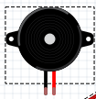
The result
Ok, its not really the Arduino that will play the music. By design it is not capable of playing music.
So we will add a buzzer :) ! (piezzo)
When you will put your hand in front of the sensor, the Arduino board will buzz the corresponding key
A buzzer looks like that -->

Slide 12
The result
Ok, its not really the Arduino that will play the music. By design it is not capable of playing music.
So we will add a buzzer :) ! (piezzo)
When you will put your hand in front of the sensor, the Arduino board will buzz the corresponding key
A buzzer looks like that -->
Also the keys will be sent to the console (do you know Serial.print?)

Slide 13
The result that you will get today
Will be one possible result .
You'll can change the setup to do something else
Hack, dicover, collaborate
Make it better
Don't be afraid
Learn, share

Slide 14
The parts (1/2)
As the setup is quite simple, only a few parts will be necessary
Parts from the starter kit :
Arduino Uno
breadboard
Wires (red is +, black is -)
Pins
Jumper wires
USB cable

Slide 15
The parts (2/2)
Additionnal parts :
4 sensors (reference HC-SR04) (the same used to create robots)
MORE wires (4 x 4 colours)
thus 16 wires !

Slide 16
The HC-SR04 sensor
Sends/receives ultra-sounds
Four are needed for the project.
In fact, it measures distances by measuring the time used by the ultra-sounds t sends to come back.

Slide 17
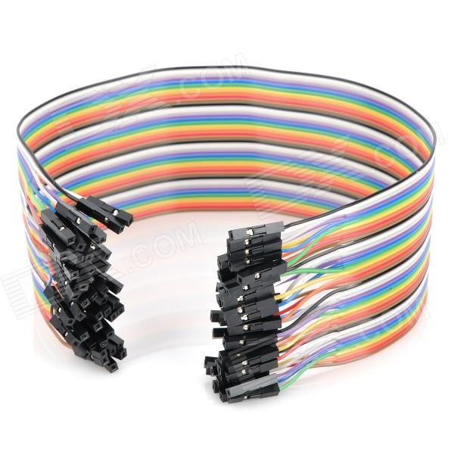
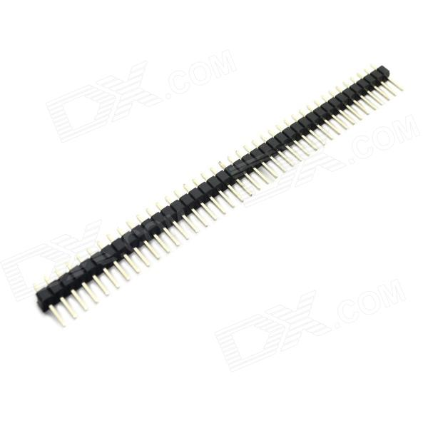
The wires
I used those wires
They need pins like this to connect into the sockets of the Arduino

Slide 18
Let's start !

Slide 19
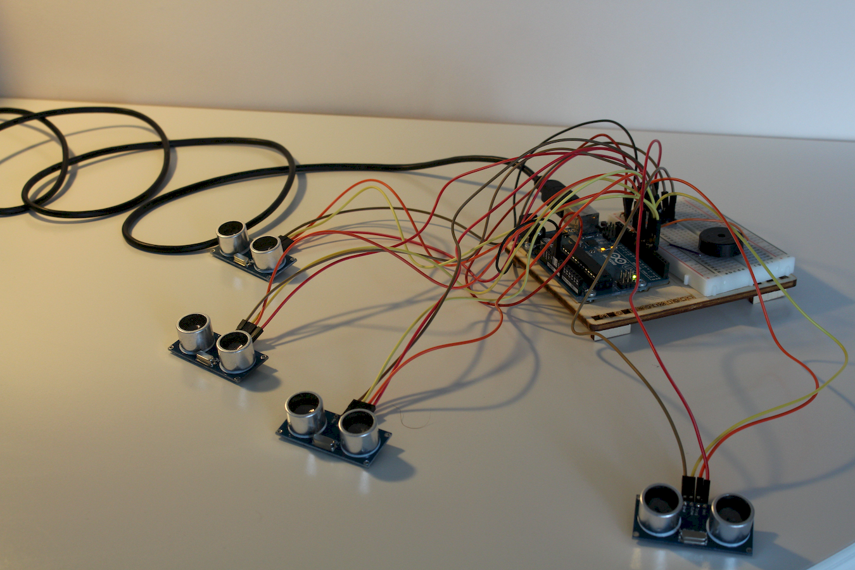
The result will be

Slide 20
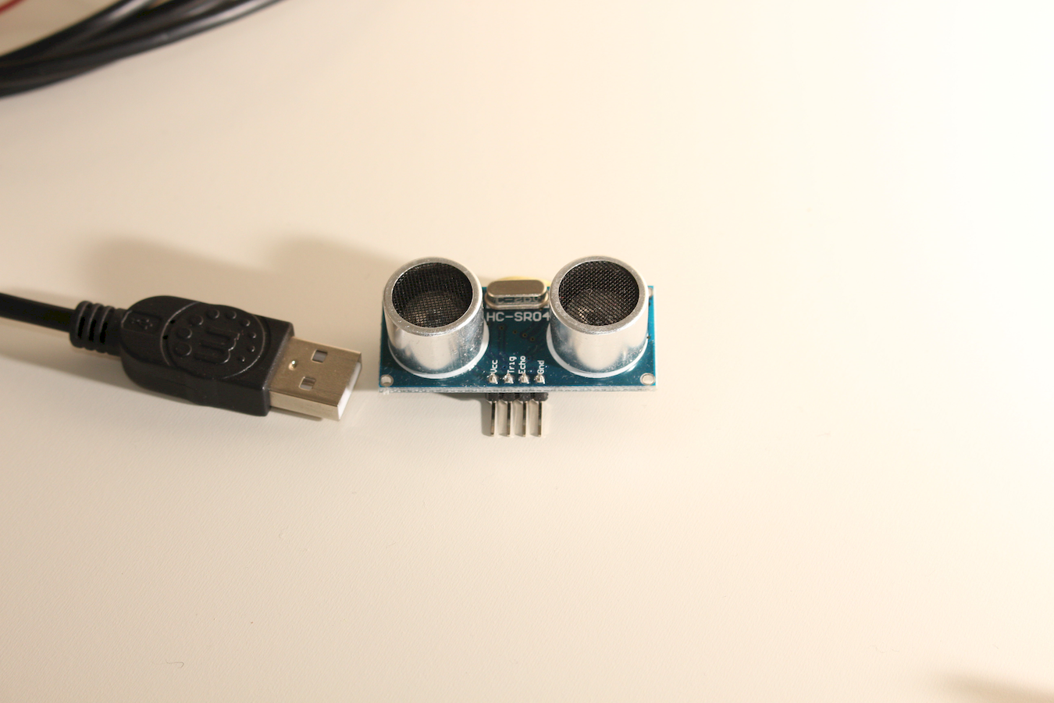
Wiring a sensor
Hey, dont plug a USB !
LOL :)
We'll need four wires of different colors. I used
Red
Orange
Jaune
and Maroon
Colors are not important (except the red), what's important is to have four sets of four different colors
(16 wires)

Slide 21
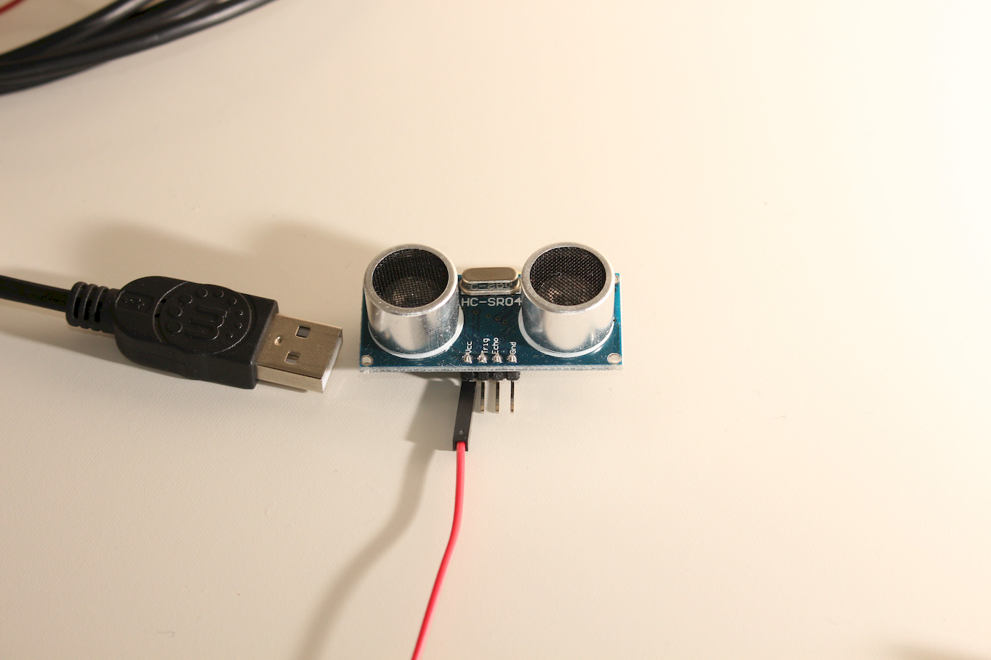
Red on « Vcc »
Apply the tradition to use a red wire for +positive
Notes:
Vcc c'est l'alimentation électrique +
Vcc is power, positive

Slide 22
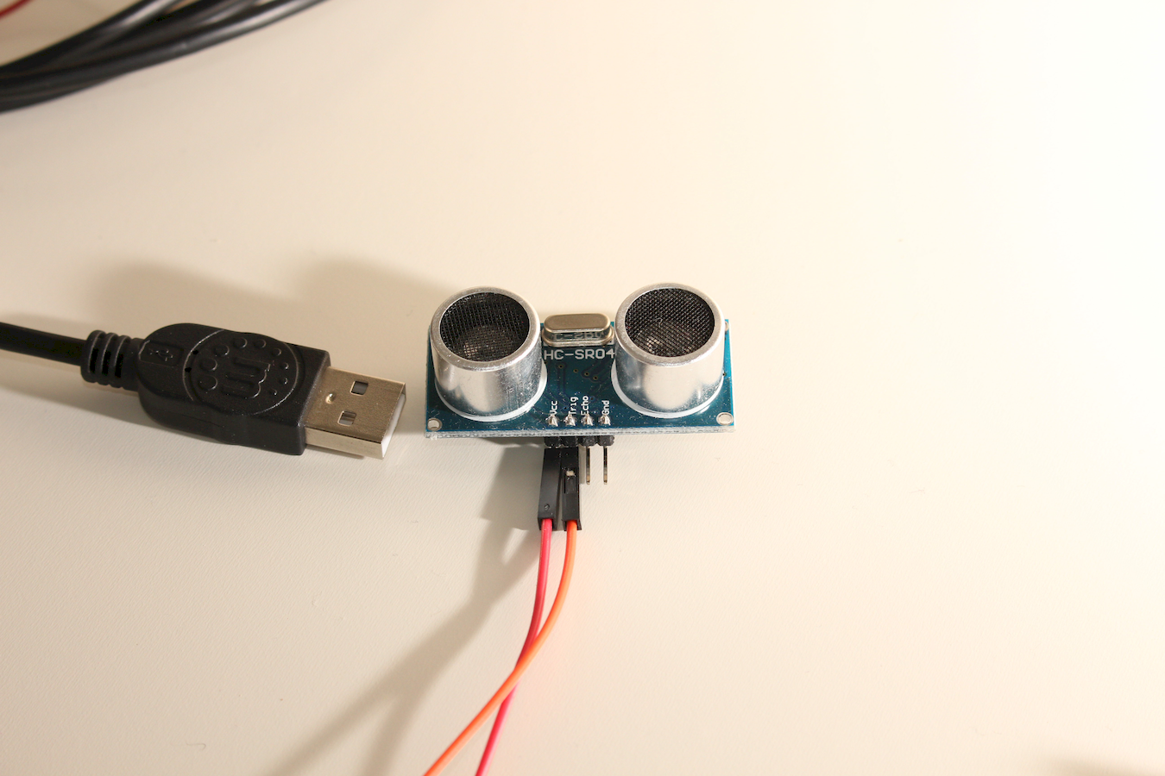
Orange on « Trig »
Notes:
Trig
Pour « trigger », gâchette (d'arme) ou le verbe déclencher
Comme on le verra dans le programme, ce sont des fils qui seront connectés sur des pins de sortie OUTPUT (de l'arduino)
Trig for trigger, I guess its for sending the ultrasounds (I cant read specs). They will be connected to OUTPUT sockets

Slide 23

Yellow on « Echo »
Notes:
Echo est le pin qui sera lu par le programme.
Comme le capteur envoie et reçois des ultra sons pour mesurer la distance, si rien n'est lu sur un pin ECHO alors il y a un probleme
Echo is the pin that will be read by the program.

Slide 24
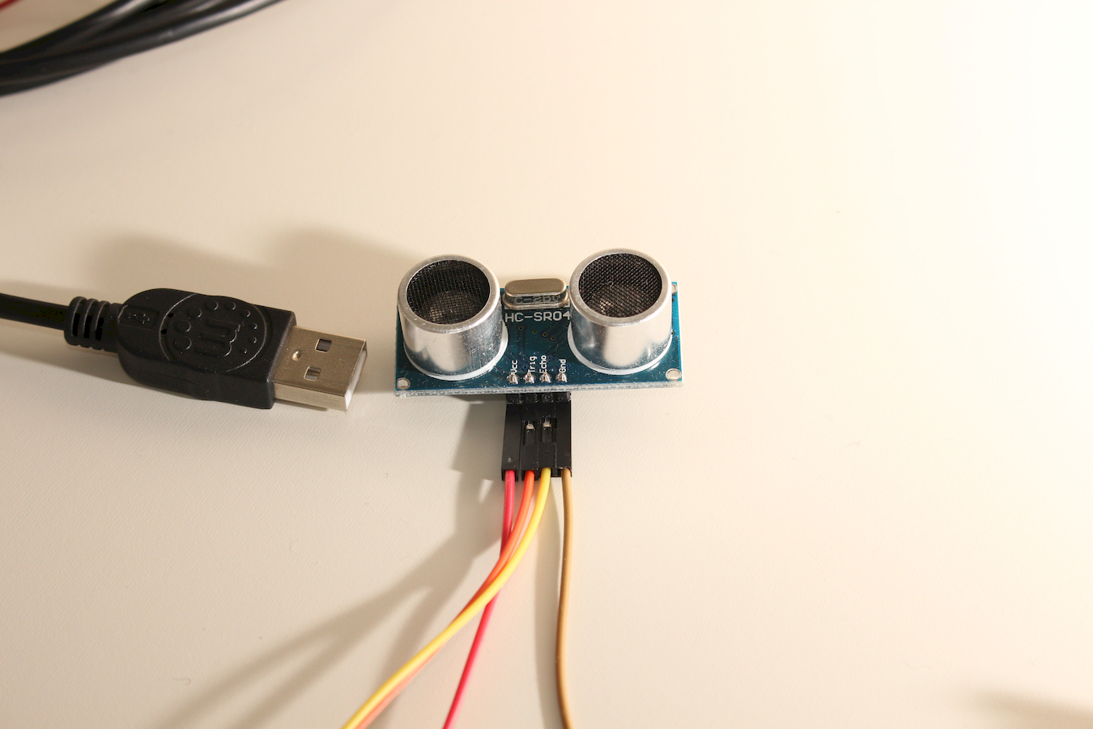
Maroon on « Gnd »
Notes:
Gnd signifie « ground », la terre. Le pole -
GND is for ground, the negative

Slide 25
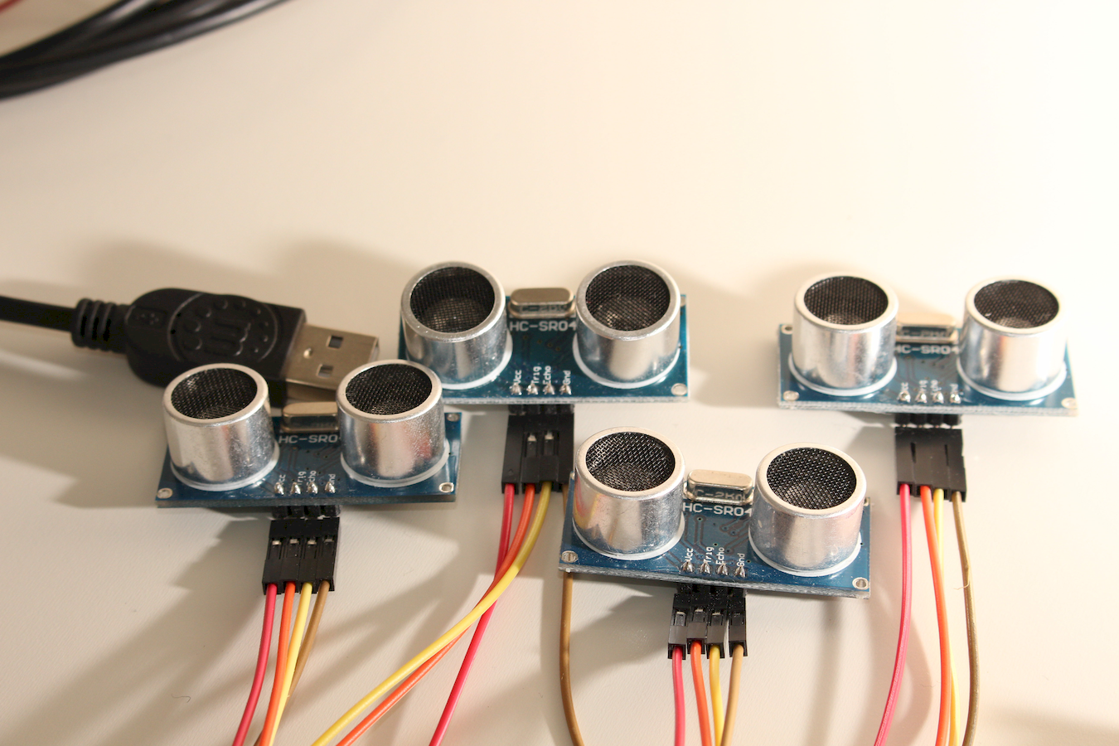
Well Done !
Remember you need four ? :)

Slide 26
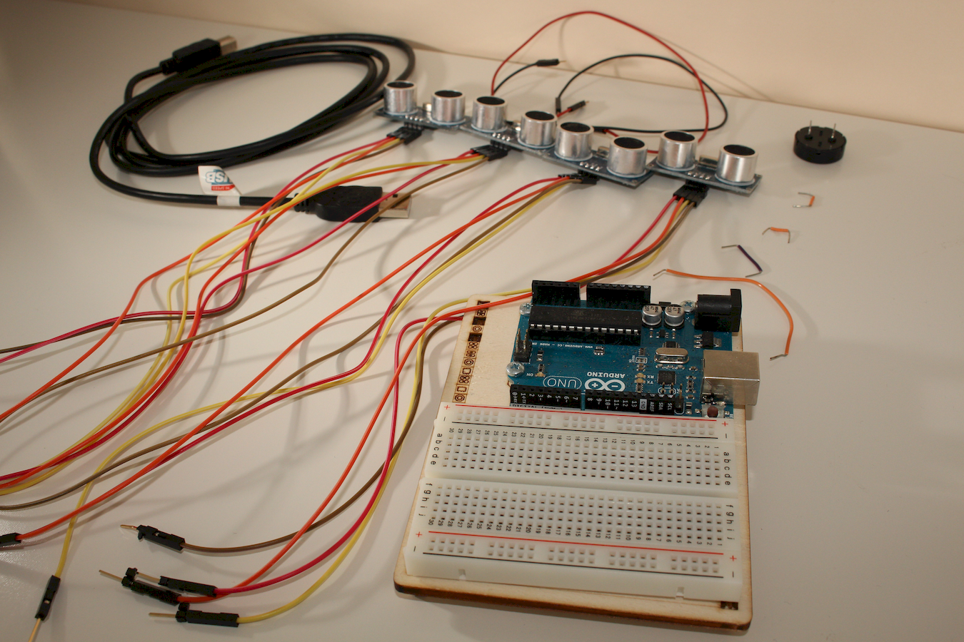
Here is what we have
Its all the parts we will use

Slide 27
It's gonna connect
We will start with the yellow wires
For each sensor, we will connect the yellow wire in the corresponding socket.
First goes into socket 4, second in socket 5 (S5), third in S6, fourth in S7

Slide 28
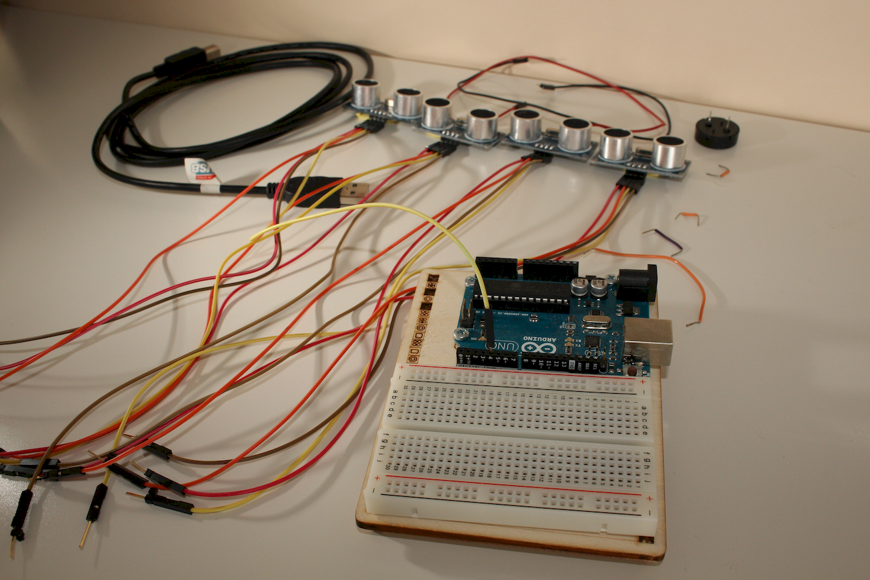
Let's do it one sensor after another,
from left to right
The yellow wire of the first sensor goes into socket 4

Slide 29
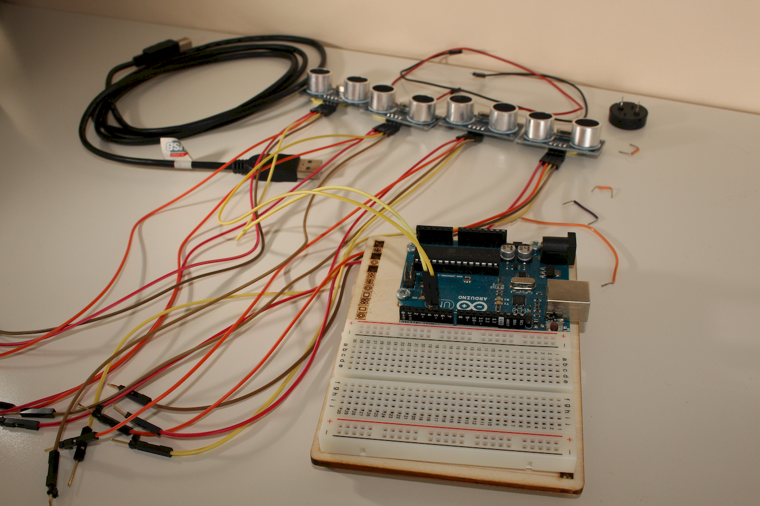
2nd sensor, 2nd wire
Socket n°5

Slide 30
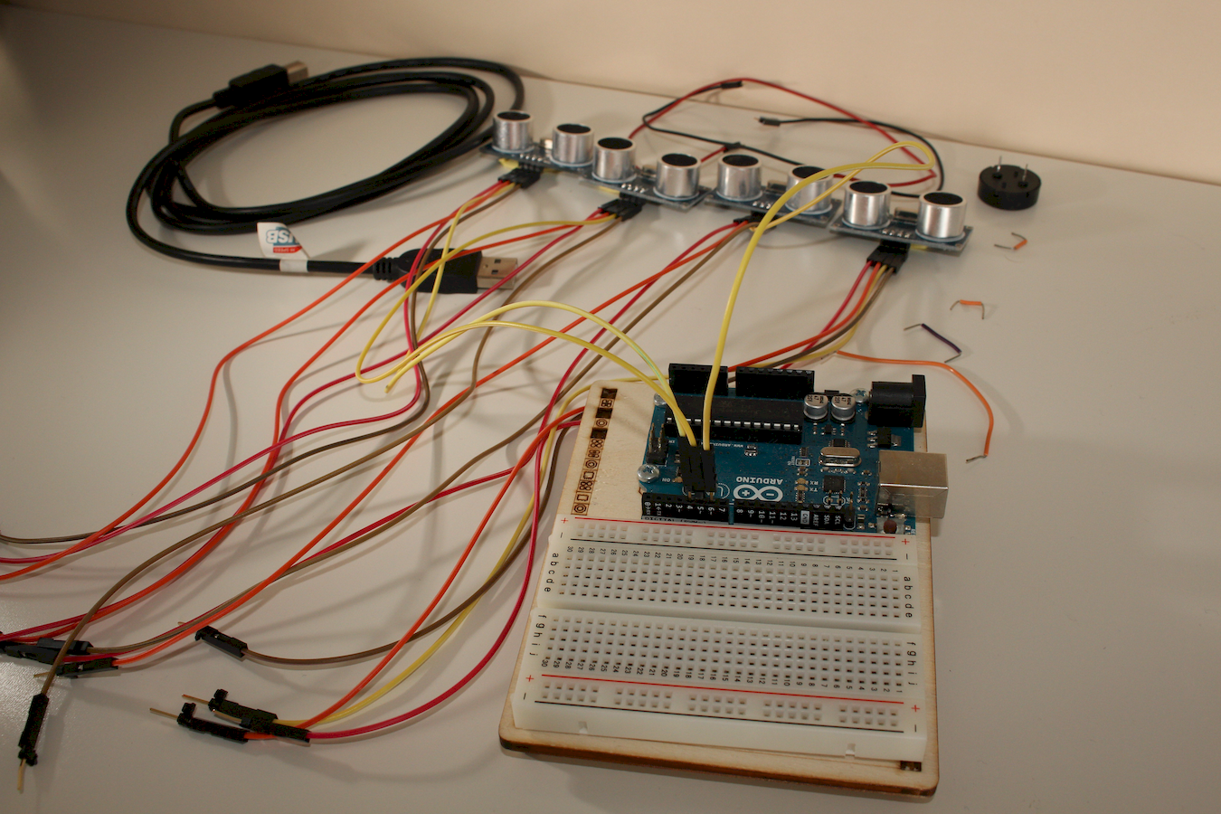
3rd sensor, 3rd wire
Socket n°6

Slide 31
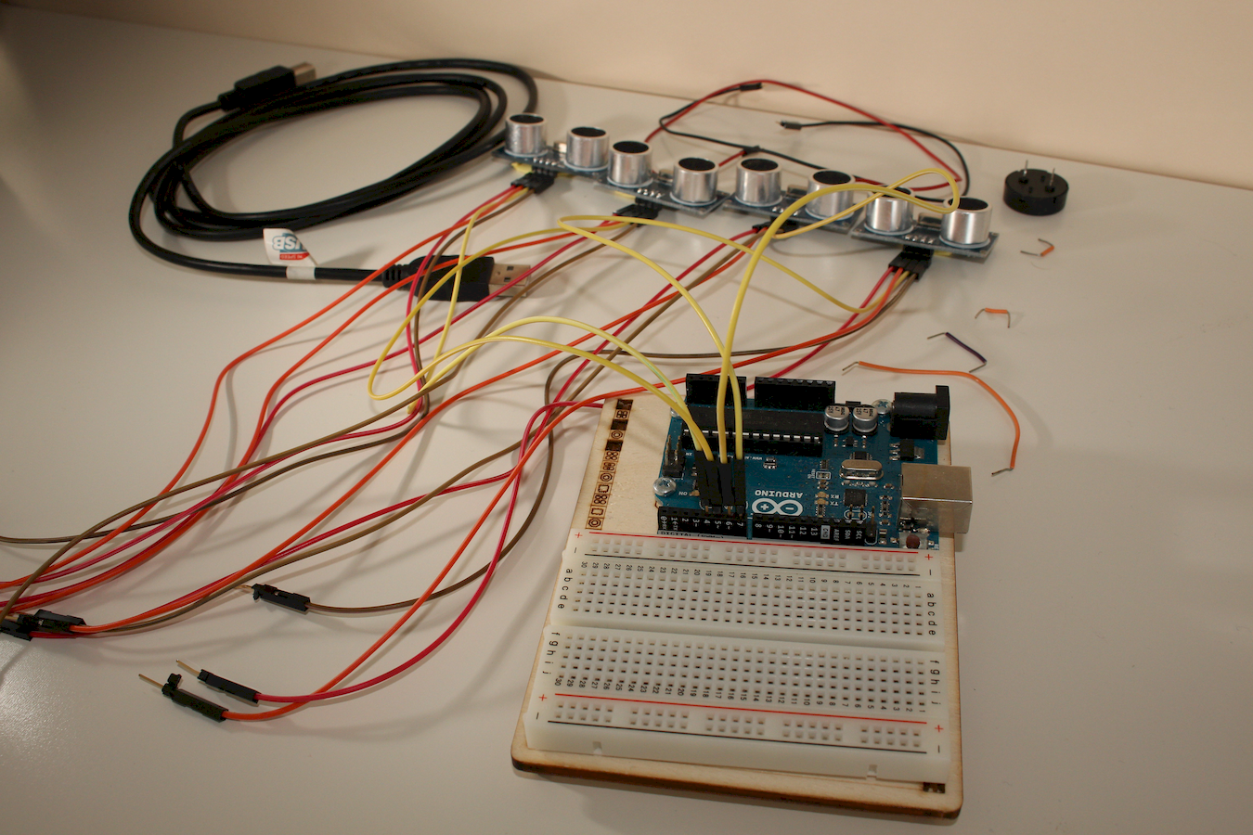
4th sensor, 4th wire
Socket n°7

Slide 32
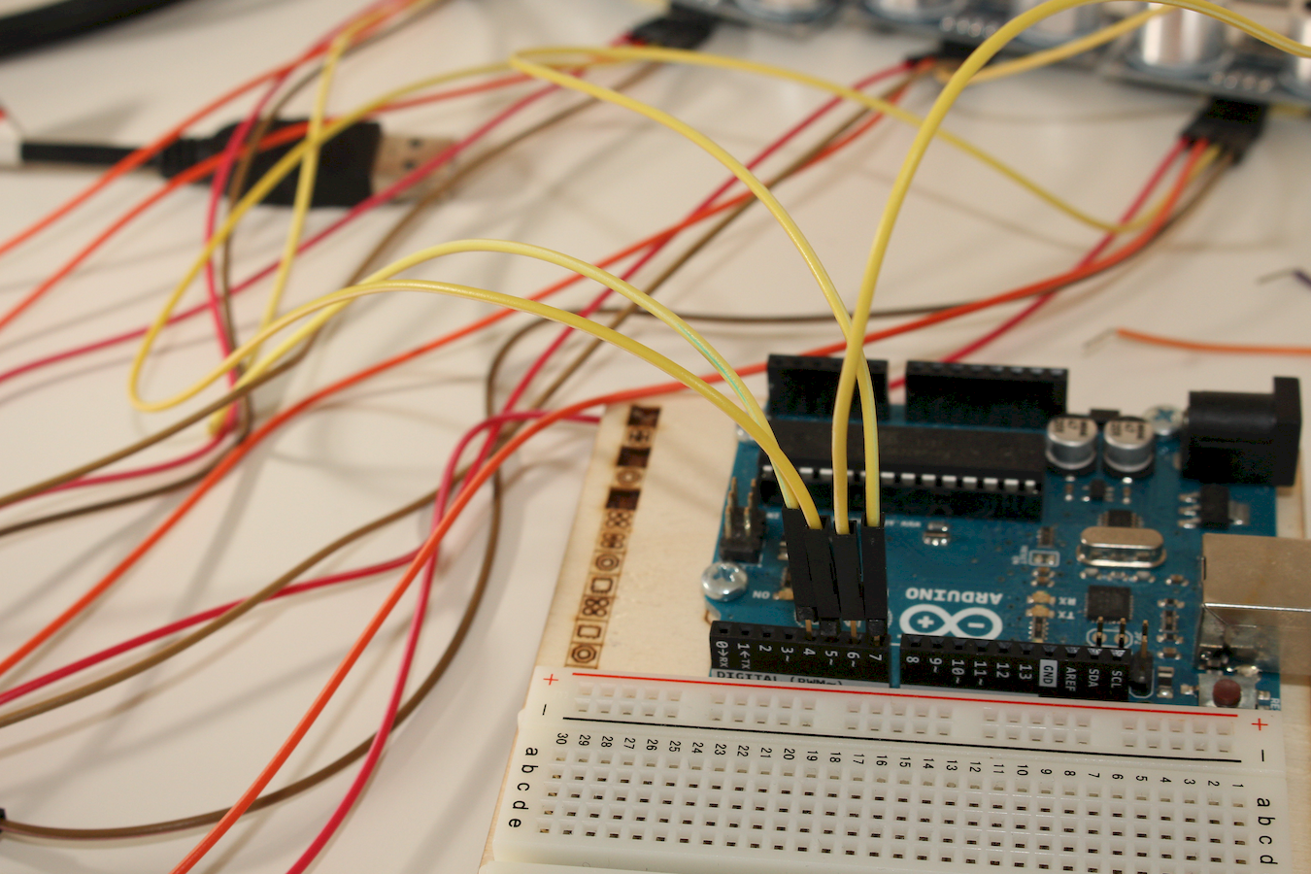
Good job !
Over for the yellow wires!
Now, the oranges !

Slide 33
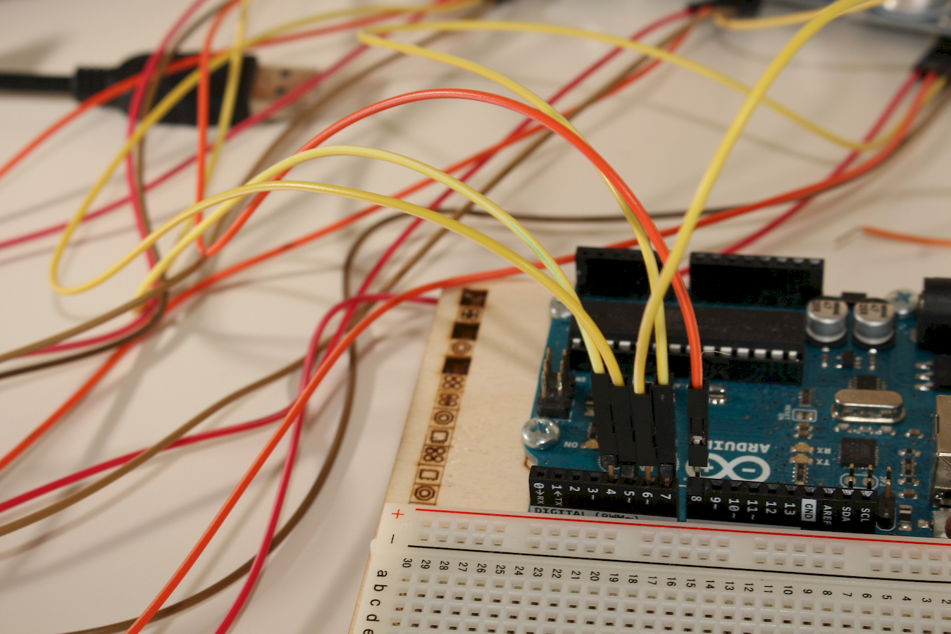
Orange 1 in 8

Slide 34
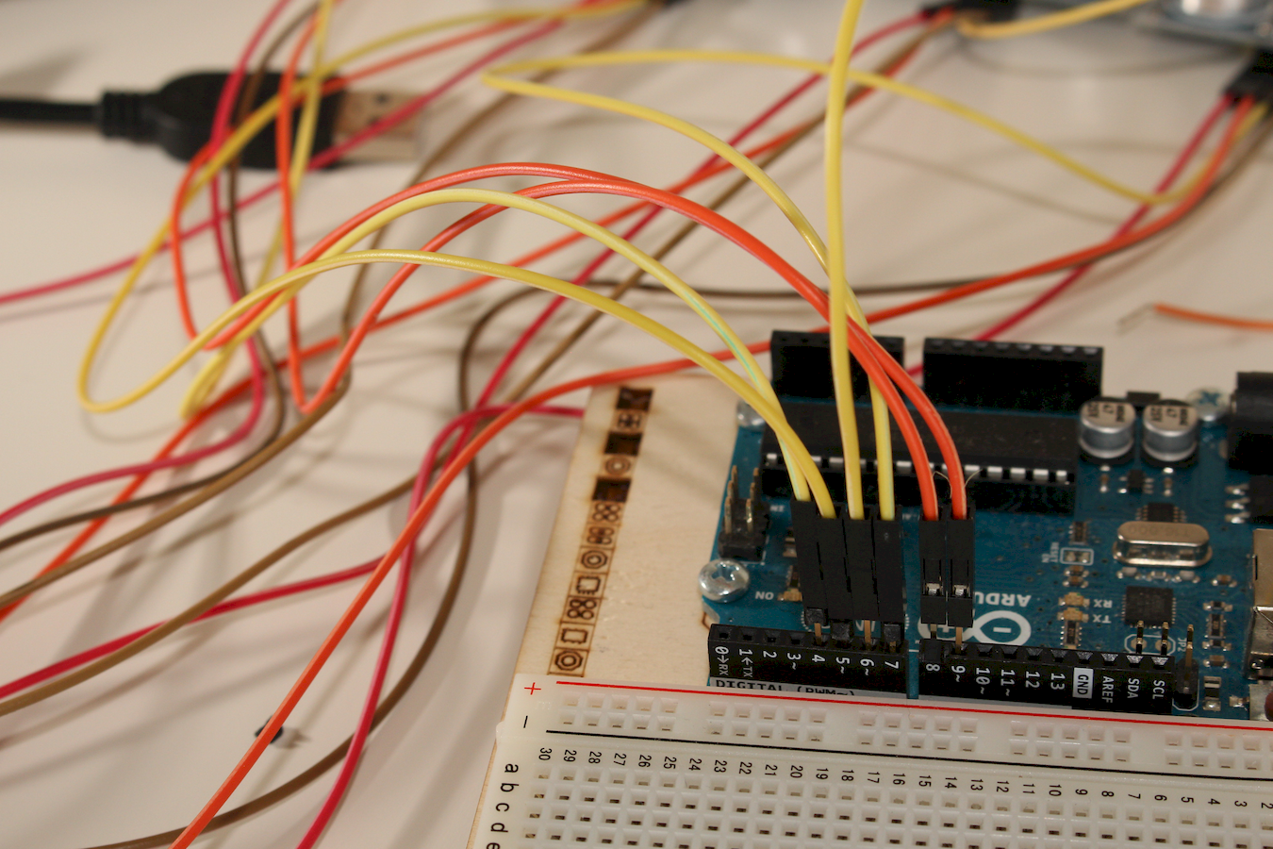
Orange 2 in 9

Slide 35
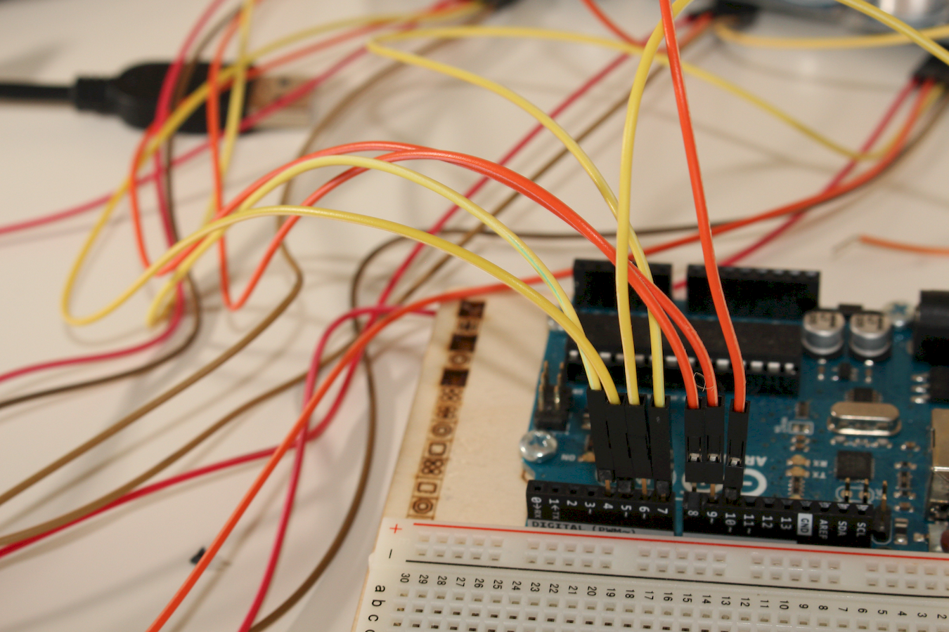
Orange 3 in 10

Slide 36
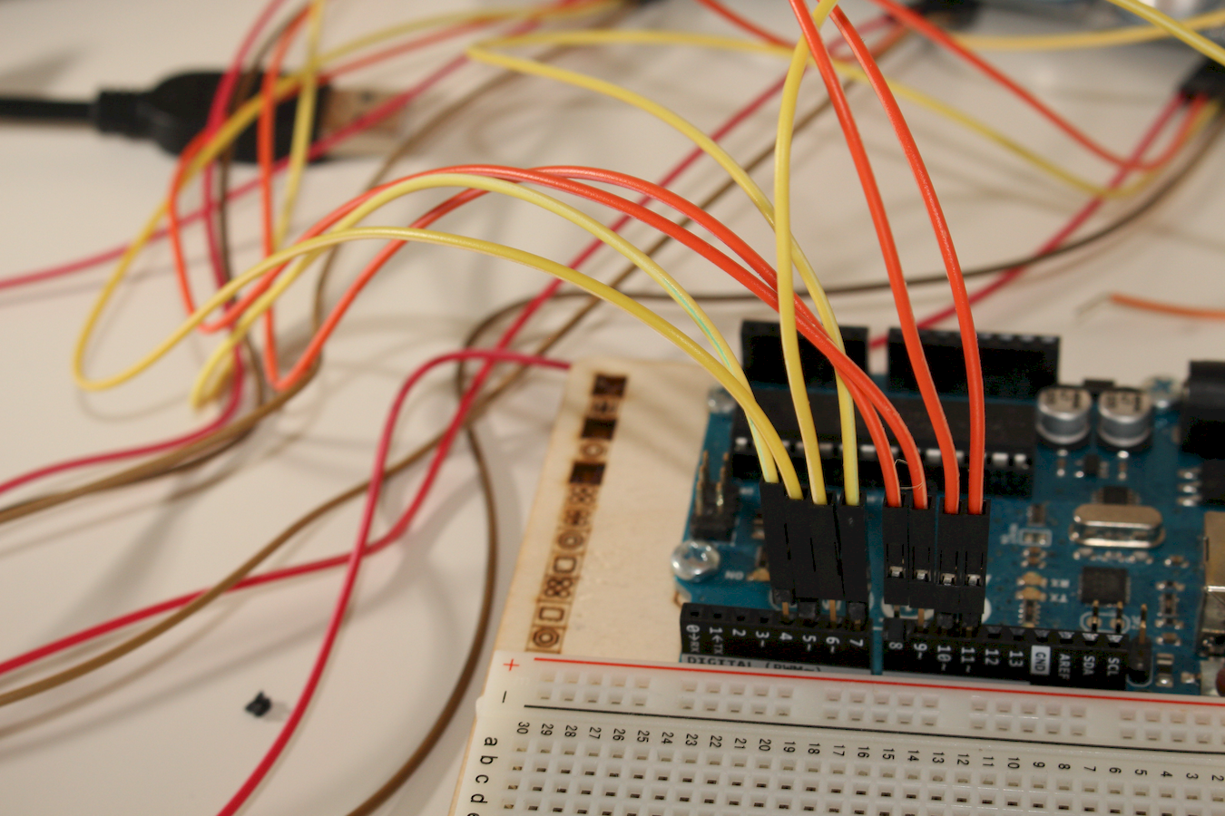
Orange 4 in 11

Slide 37
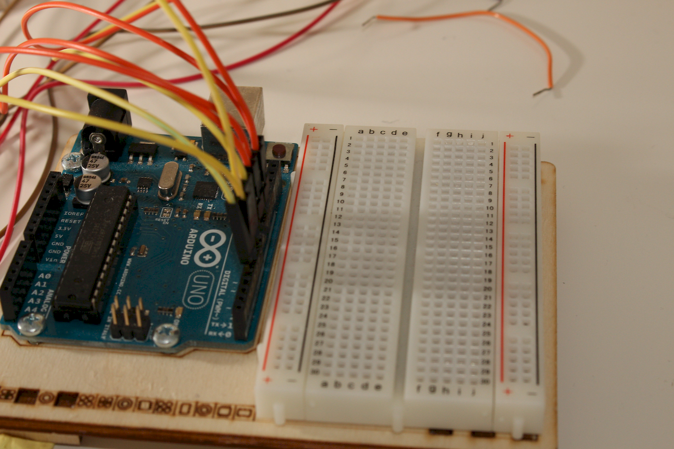
Let's continue

Slide 38
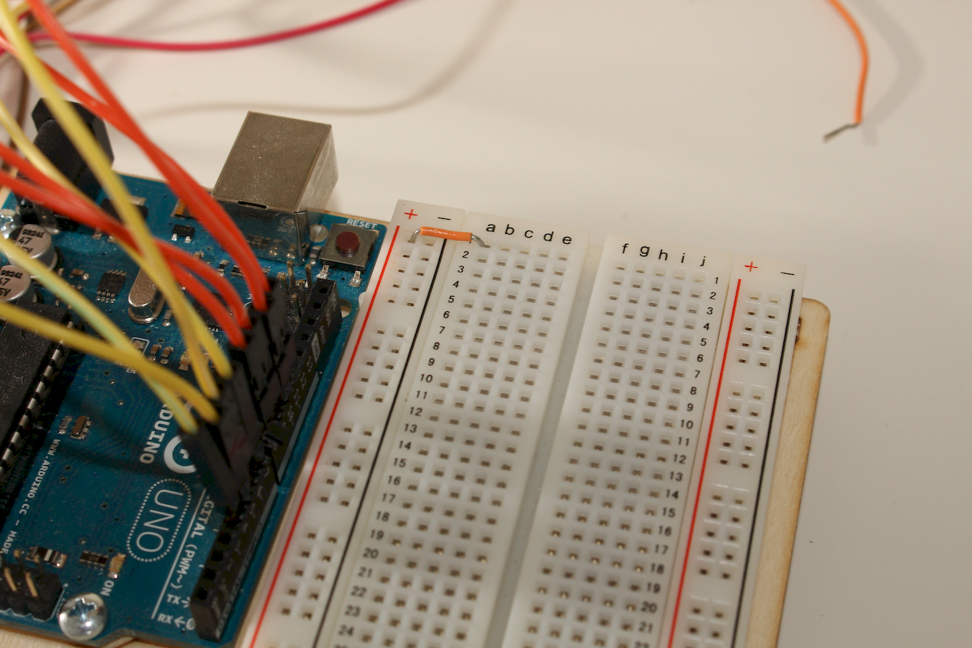
Jumper 1

Slide 39
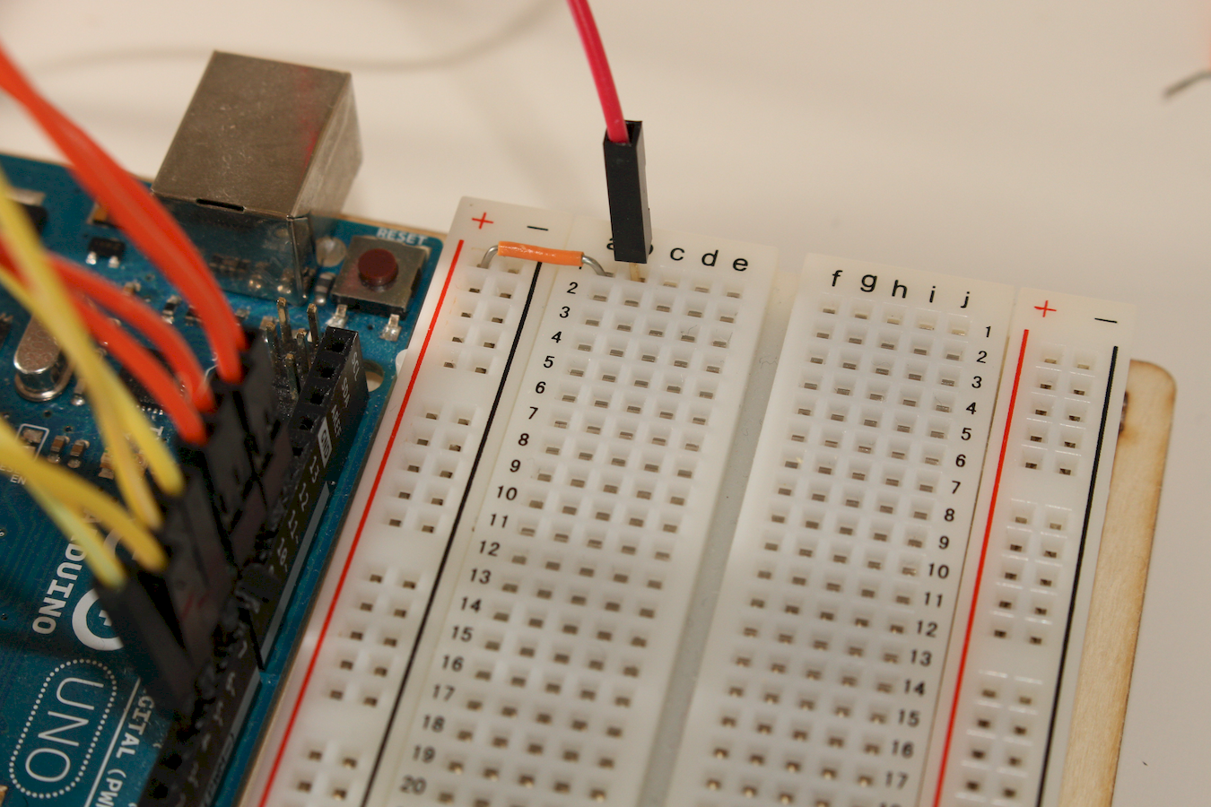
Red 1

Slide 40
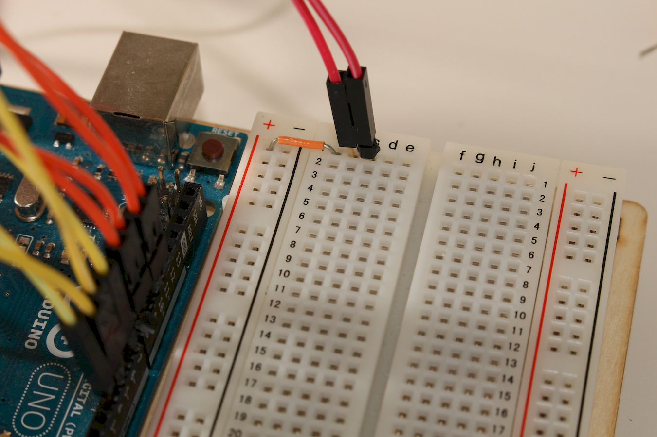
Red 2

Slide 41
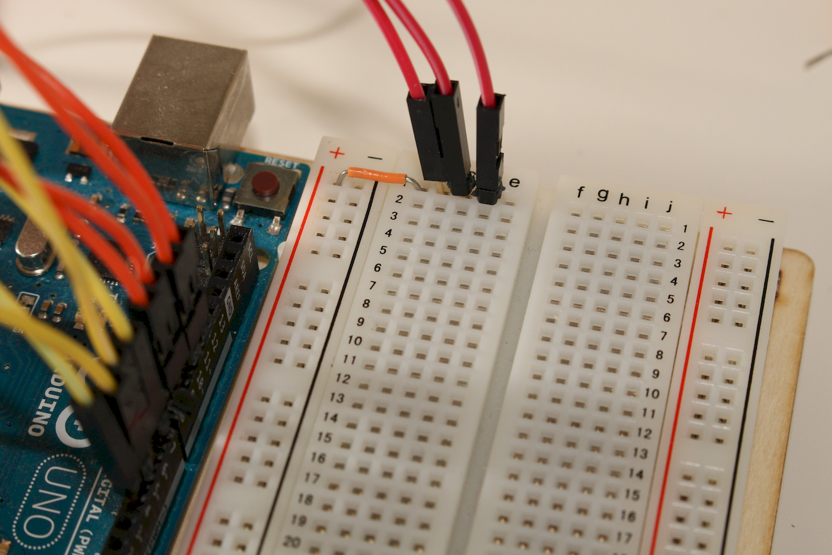
Red 3

Slide 42
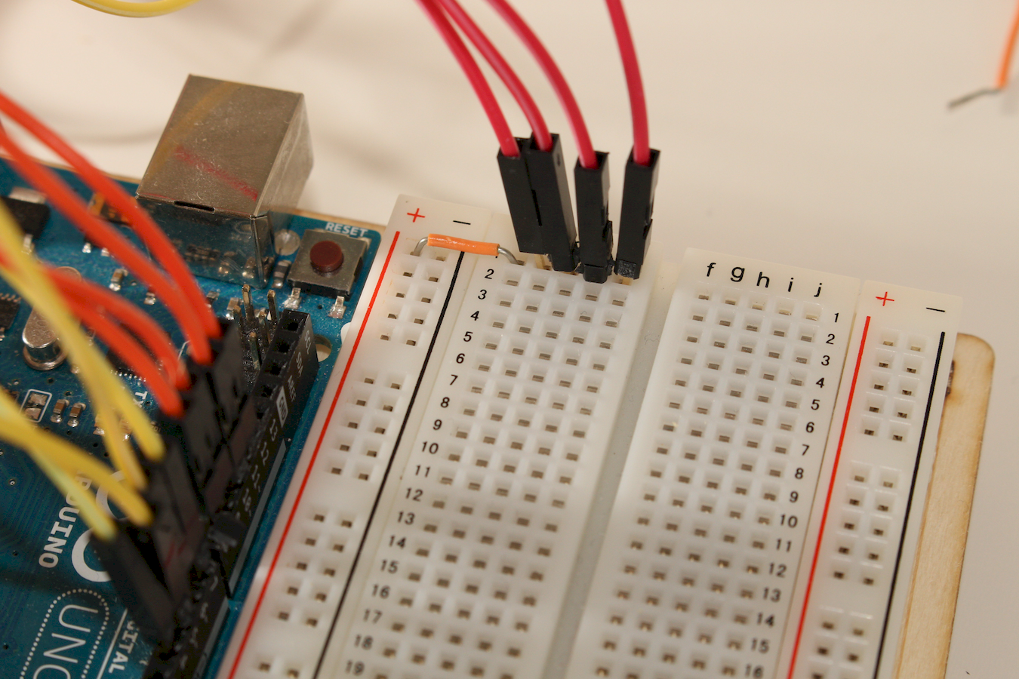
Red 4

Slide 43
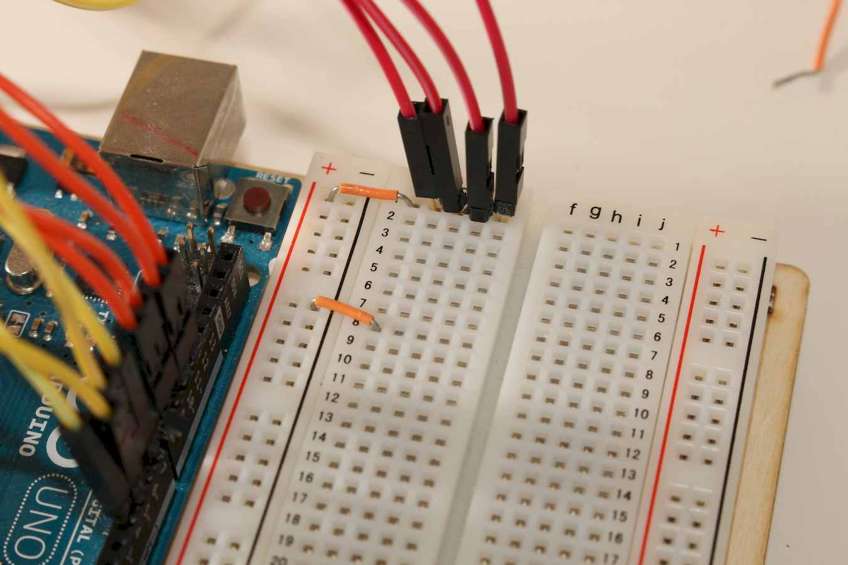
Jumper 2

Slide 44
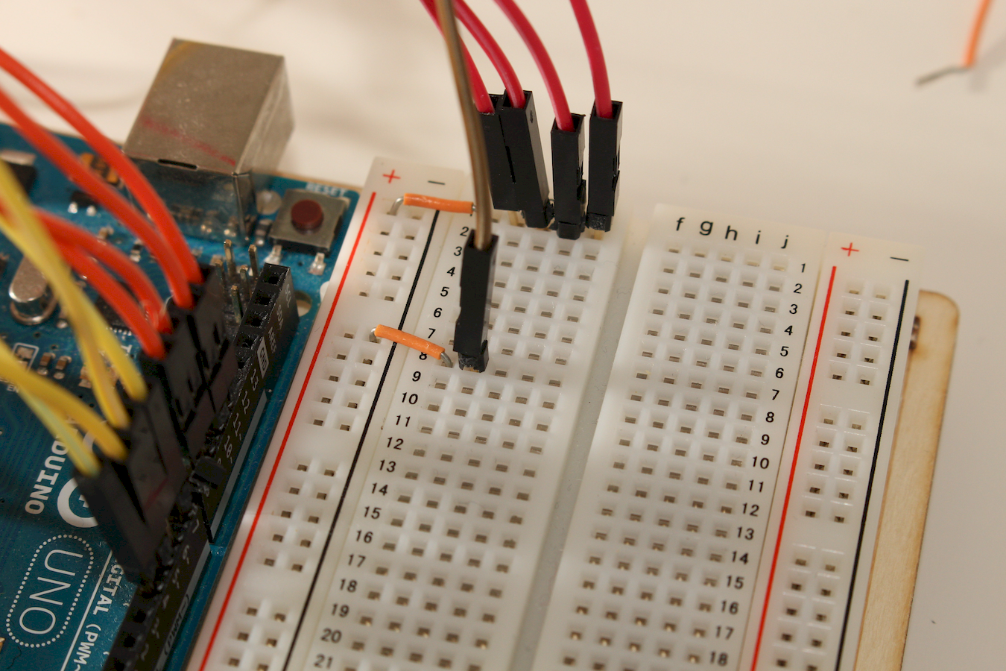
Maroon 1

Slide 45
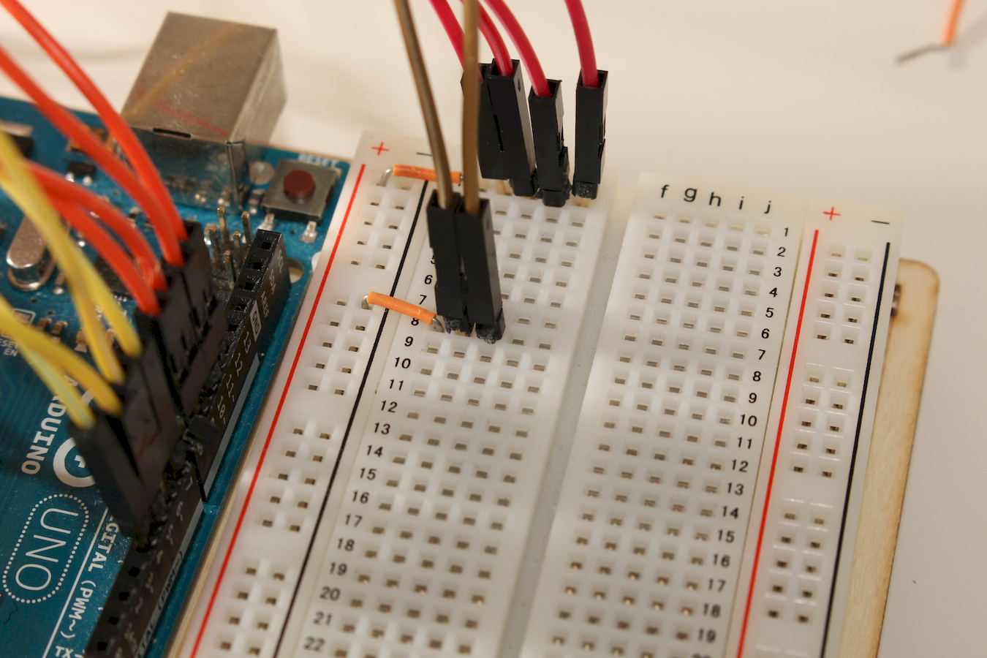
Maroon 2

Slide 46
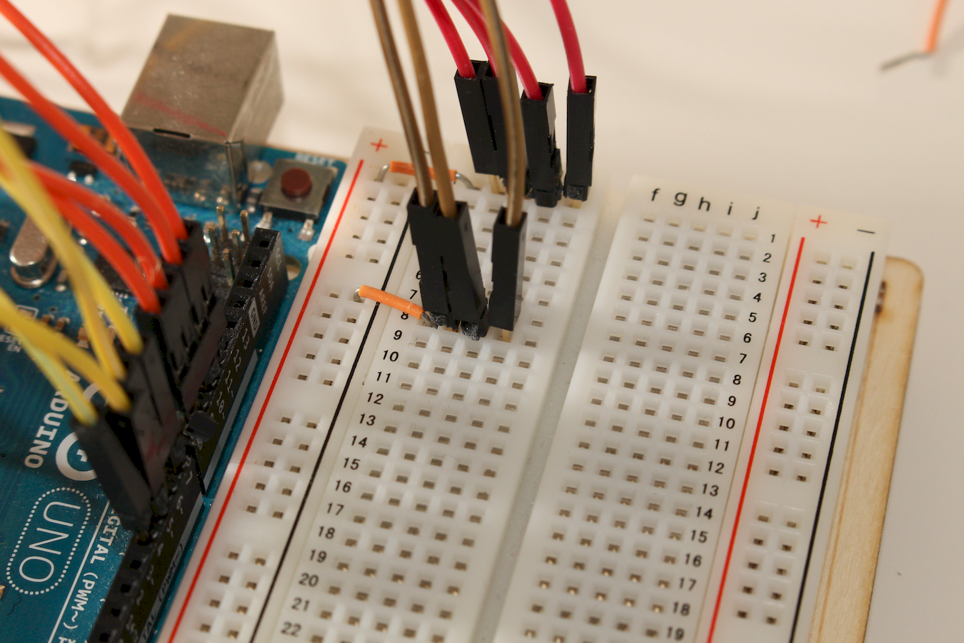
Maroon 3

Slide 47
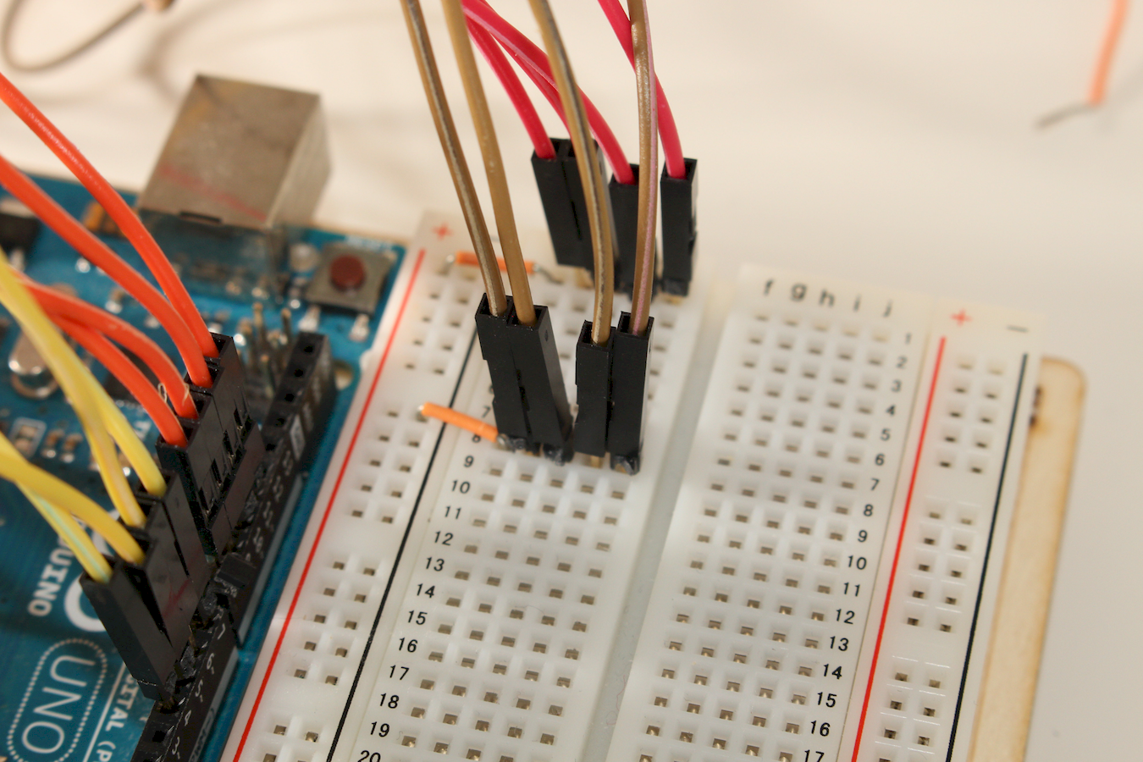
Maroon 4

Slide 48
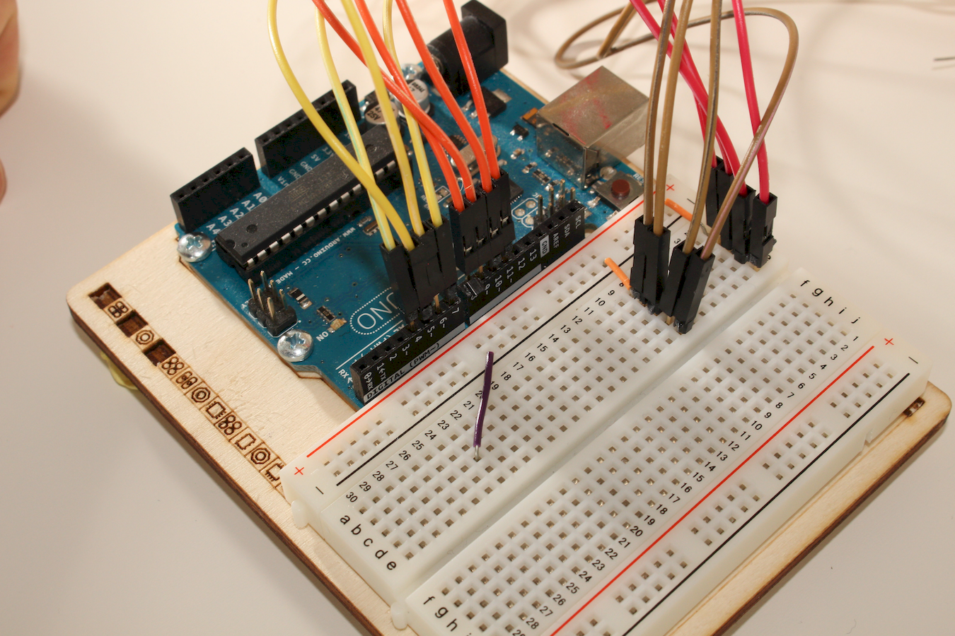
Jumper 3

Slide 49
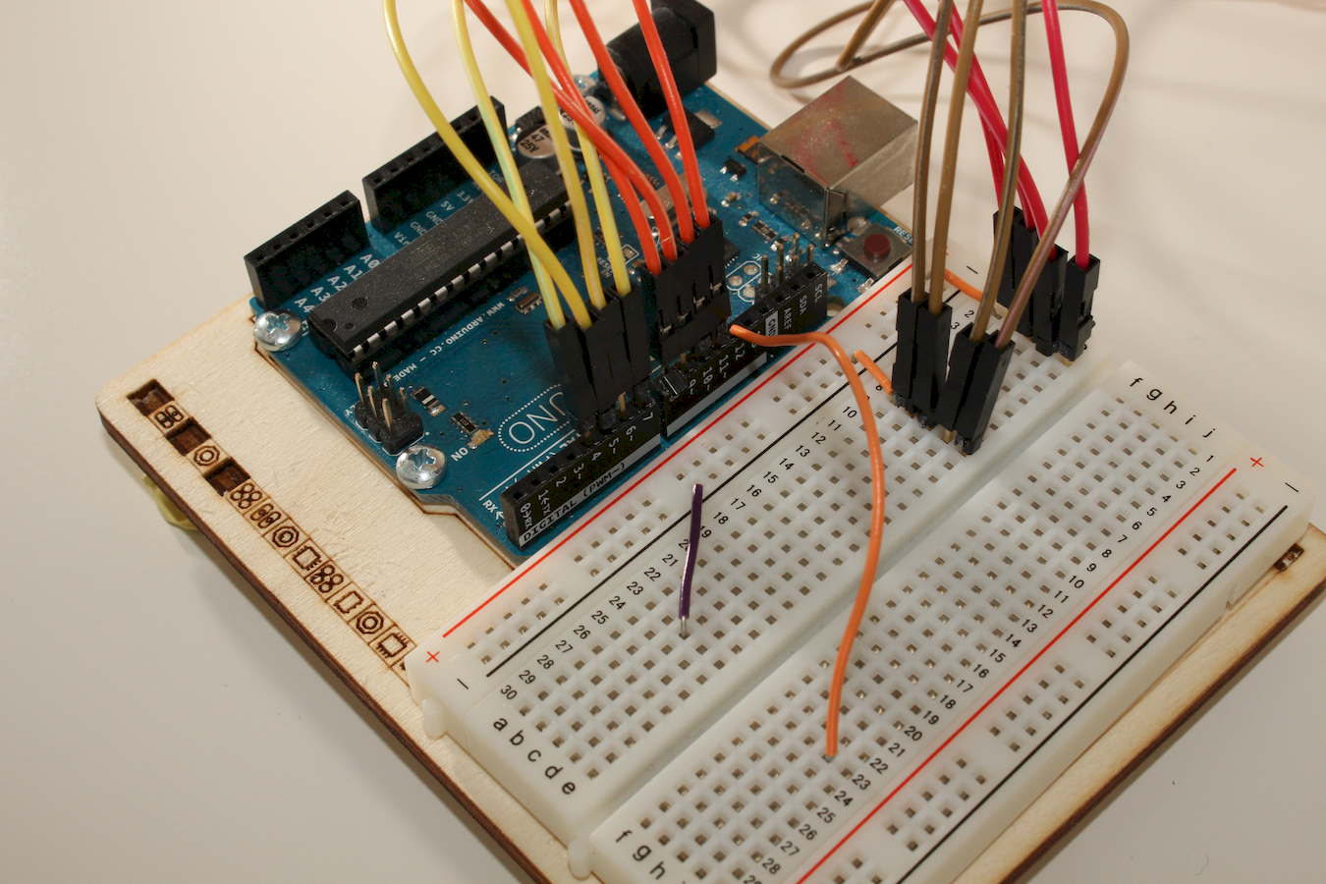
Jumper 4
Notes:
A mettre dans le pin 12 et sur la même ligne de la planche à pain

Slide 50
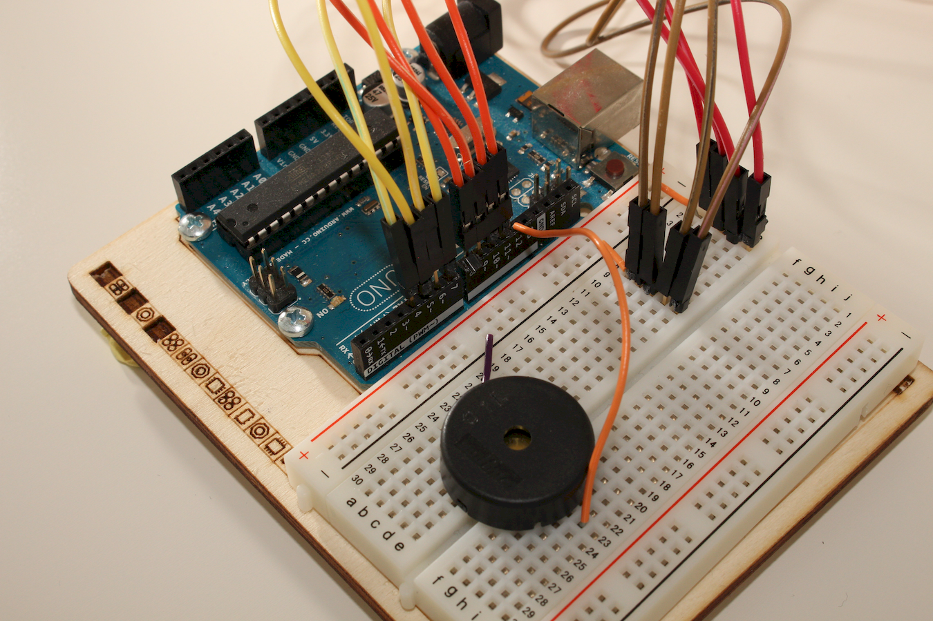
Notes:
Bine mettre les deux pattes du buzzer sur la même ligne que les jumpers 3 et 4

Slide 51
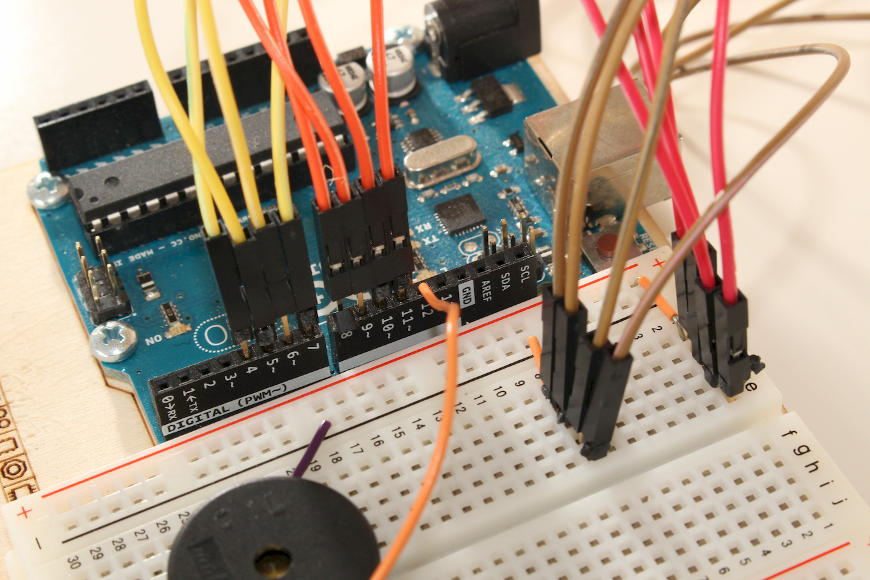

Slide 52
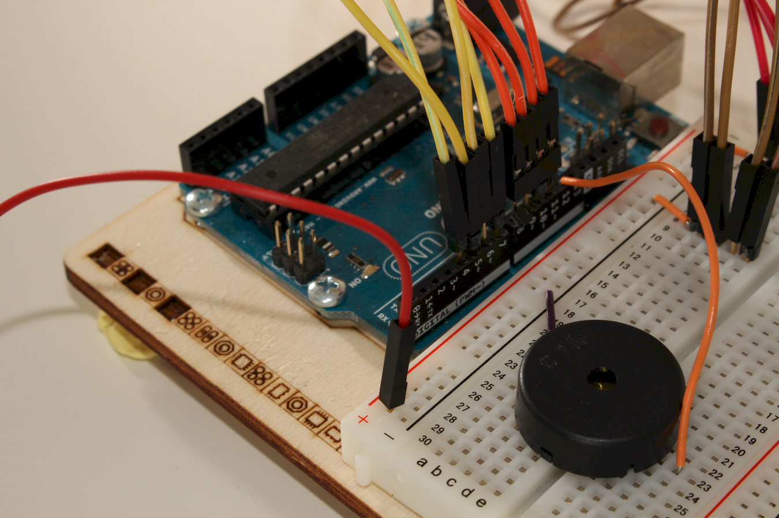

Slide 53
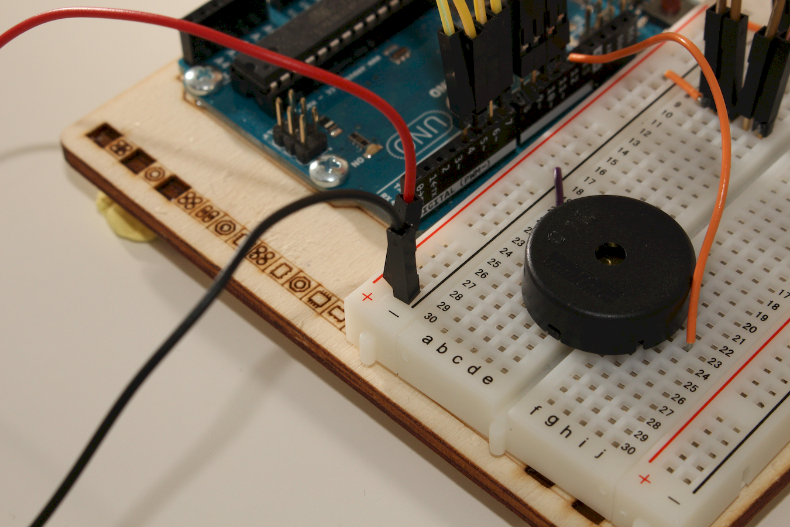

Slide 54
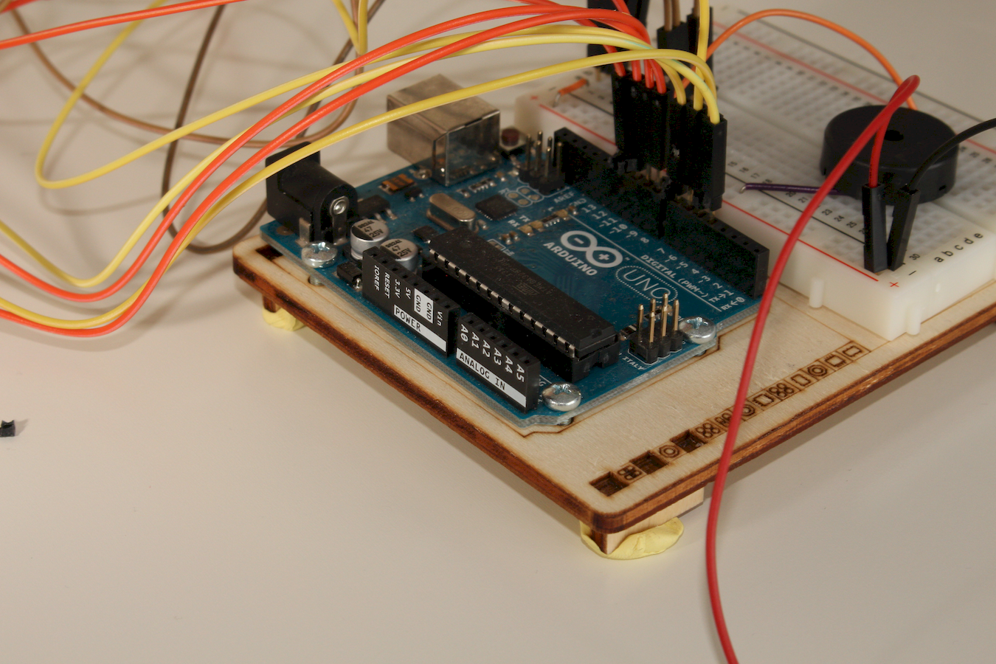
As we are dealing with the power wires, it means we are close to the end of the setup

Slide 55
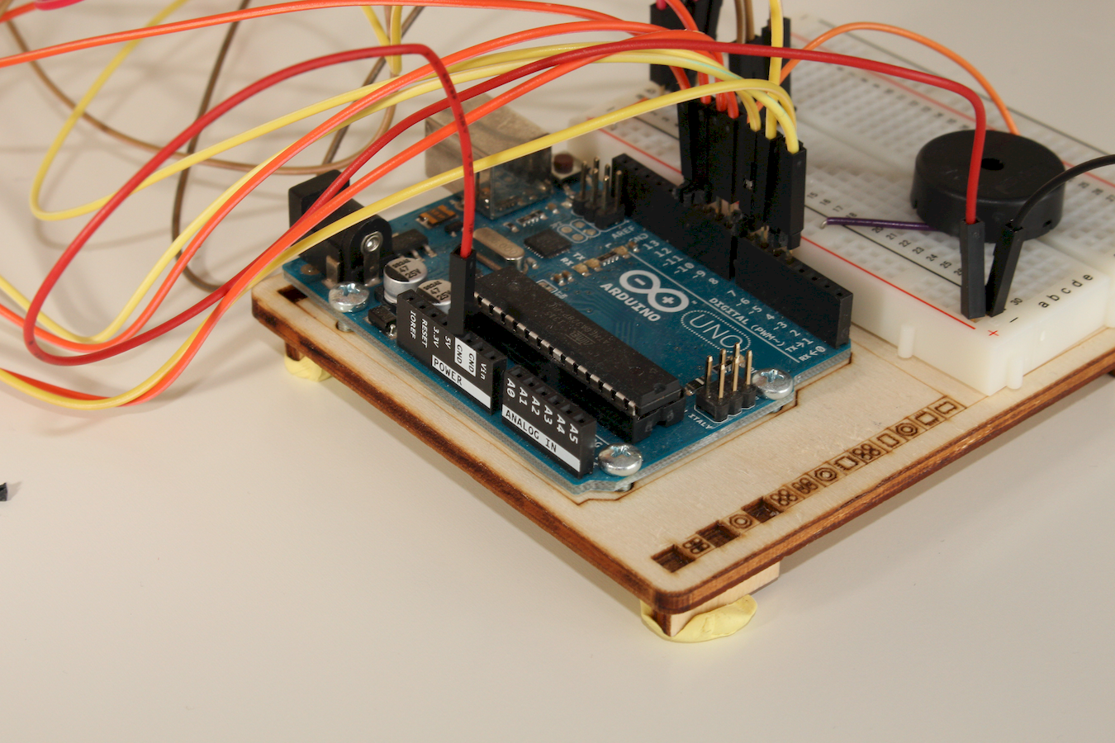

Slide 56
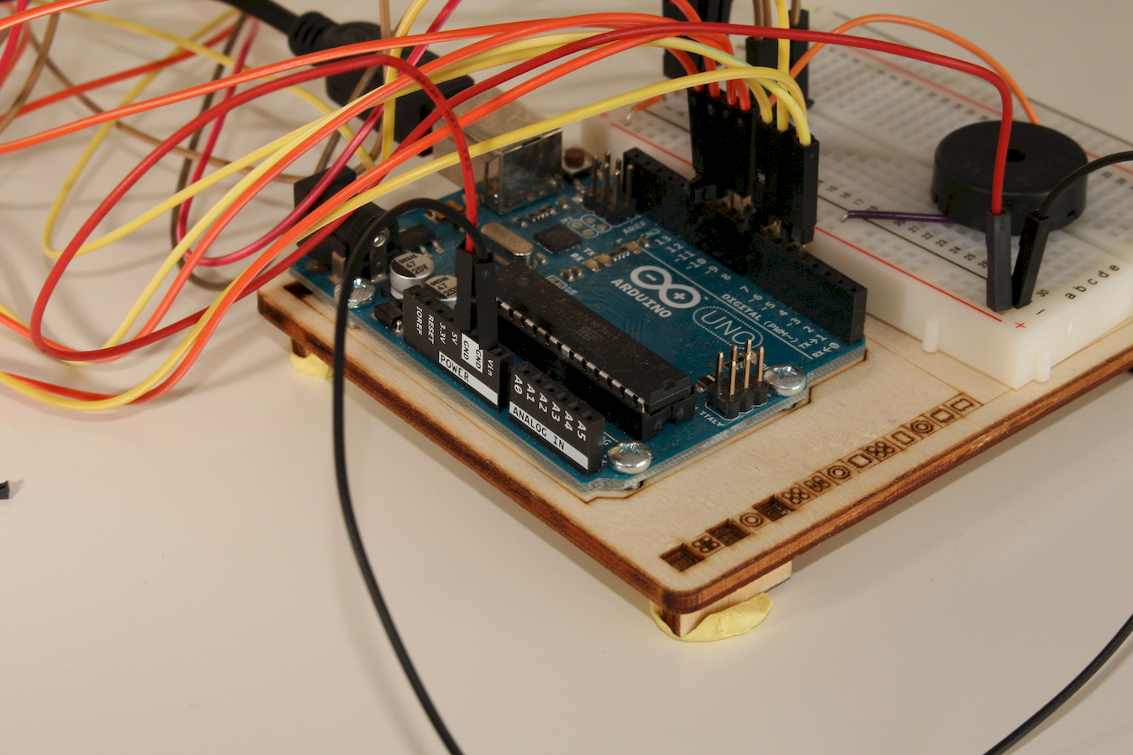

Slide 57
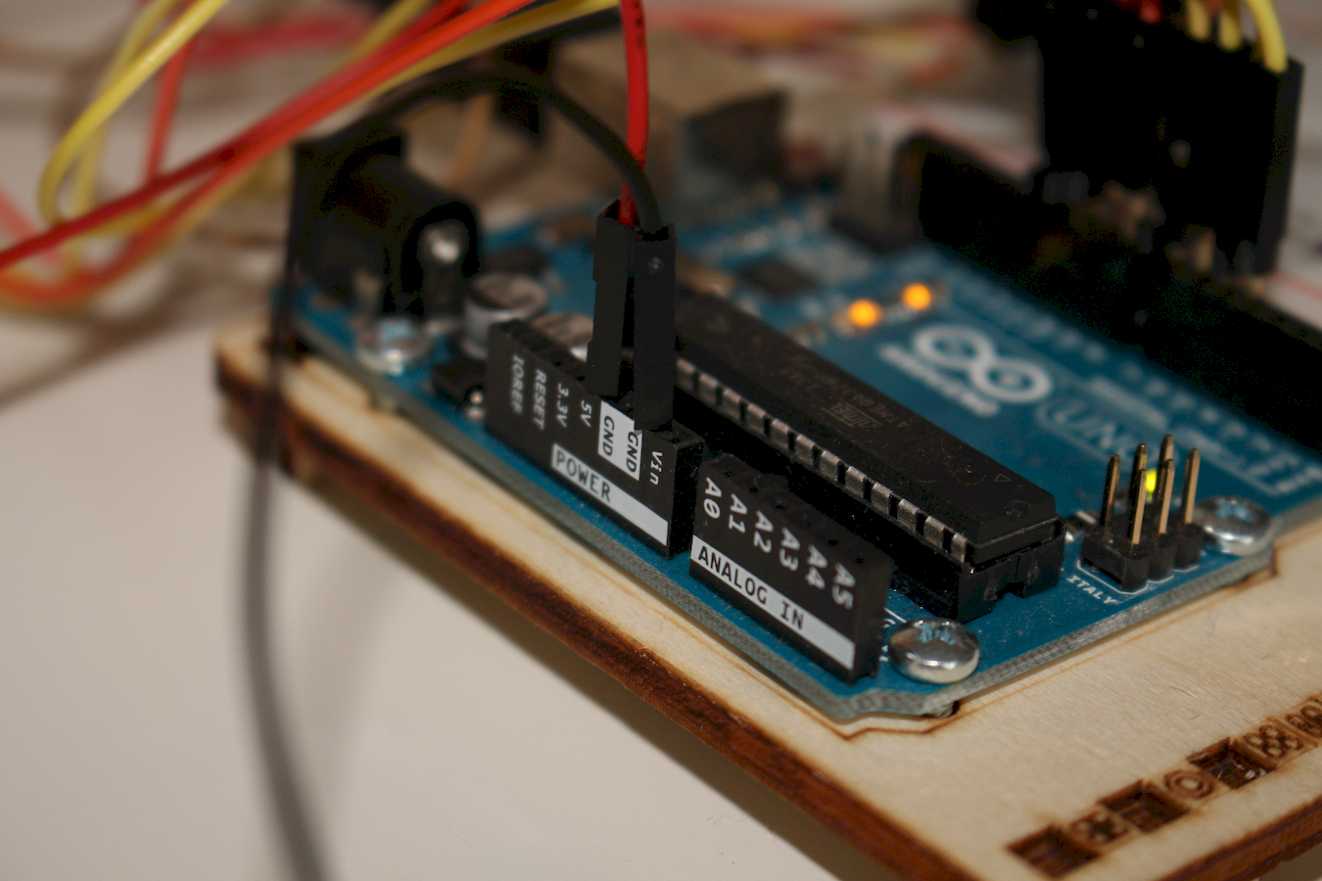
Red wire goes into a 5V socket,
Black wire goes into a GND socket

Slide 58
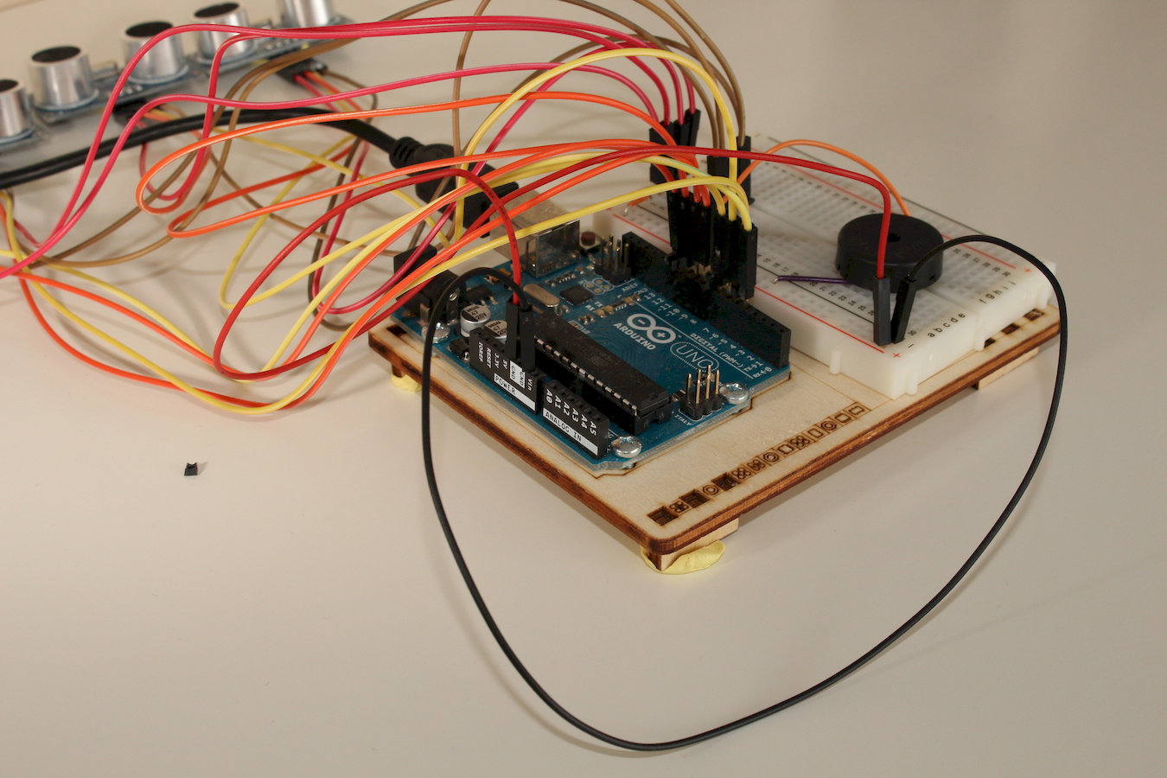

Slide 59
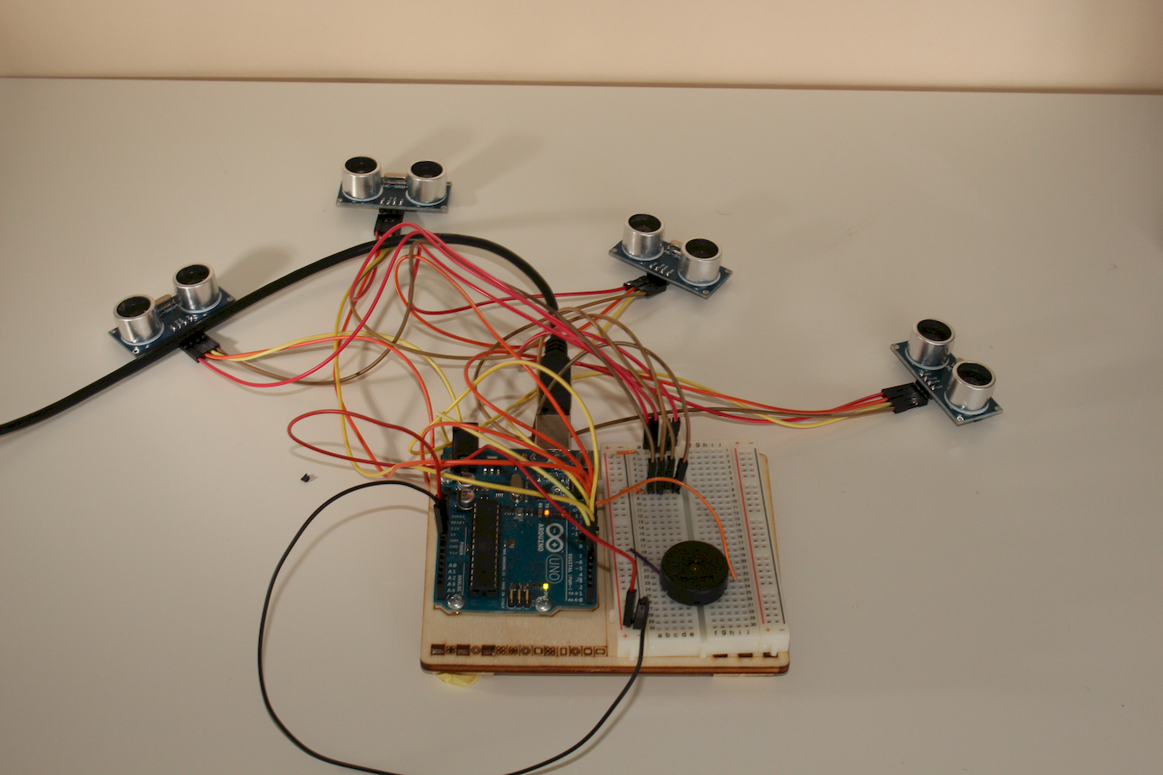
Before to connect your setup to the computer, check it.
(by browsing the slides again)

Slide 60
Is everything OK ?
Well done !
Good job !
Next steps need to use a computer !

Slide 61
On the computer
Launch Arduino IDE
Open the project « sketch »
Upload it to the Arduino board
If you don't already know how to do, ask the event-leaders around you for help

Slide 62
Wow, what now ?
Have fun playing some music !
Tweak the program
Which song do you know ?
Else let the internet help you

Slide 63
Tones without playing ?
If you experience musical note without playing that means that your sensor are too close from one another. Put space between them.

Slide 64
WE WANT MORE !
I am sure you have a lot of ideas to modify the project and make it do even more stuff.
C'mon, lets do a little BRAINSTORMING all together to share our ideas (max 10 minutes).
I put some ideas in the next slide.
Will we have the same ideas ?

Slide 65
Ideas
More notes per sensor
Physical clues to indicates the ranges
More sensors
Add buttons to modify the length of the notes
Buttons to change the sound (like buzzer on/off)
Add lasers, LCD screen
Make the computer play the notes

Slide 66
More ideas
Use another library to read the sensors
Allow to record a serie of notes to make it replayed over and over.

Slide 67
Have fun !

Slide 68
Photo credits
Jérôme Baton, 2015, www.wadael.org
Notes:
Pour me contacter
wadael@gmail.com
Ou @wadael sur twitter
Ou https://fr.linkedin.com/in/jeromebaton
Je suis basé sur la région parisienne

